Slide 1
ALGAE General Characteristics
Class Teacher
Dr. Sana Khalid
Assistant Professor (BPS-19)
Department of Botany
Lahore College for Women University, Lahore Pakistan.
Course Description
Course Title: DIVERSITY OF PLANTS
Course code: Min/Bot-102
Credit hours: 4 (3+1)
Class
Course : BS I, 2nd Semester
Major: CHEMISTRY
Minor course: Botany

Slide 3
Algae are the chlorophyllous thallophytes that can manufacture their own food and they produce O2 during photosynthesis. So they are called as autotrophic thallophytes.
The term thallus is used for a plant body that is not differentiated into root, stem and leaves and lacks vascular system.
The study of algae is known as PHYCOLOGY (phycos---seaweed).
Algae have simple, unicellular, non-jacketed sex organs and have no embryo development.
Habit and Habitat: The algae are predominantly aquatic and are found both in fresh and salt water habitats. According to the habitat the algae can be classified as
A. Aquatic Algae----Majority of algal genes are aquatic. They are found in ponds, lakes, ditches, streams, running water and oceans e.g., Volvox, Chara etc.
B. Terrestrial Algae----A few species are terrestrialfound growing on moist, shady soils or rocks. E., Vaucheria, few species of Nostoc.
C. Aerophytes----Such algae adopted for aerial mode of life and occur in tree trunks, moist wall etc.
D. Cryophytes----They are found on mountain peaks covered with snow. They impart color to mountains. E.g., Chlamydomonas

Slide 4
E. Thermophytes----These algae occur in hot springs. They can tolerate upto ^{о}C. E.g., Haplisiphon
F. Algae of unusual habitat----Some species grow on or inside other plants (epiphytes and endophytes). Other species form a symbiotic relationship with fungi (lichens) or bryophyte thalli (Anthoceros). Some algae live in or out side the animal body (Zoochlorella) (Paper-2; Diversity of plants by Tanveer Ahmad Malik and Dr. Hammad Ashraf).
For instance, algae can photosynthesize like plants, and they possess specialized structures and cell-organelles, like centrioles and flagella, found only in animals.
Algae can be either unicellular or multicellular organisms
Reproduction in algae occurs in both asexual and sexual forms. Asexual reproduction occurs by spore formation.
Algae are free-living, although some can form a symbiotic relationship with other organisms. (https://byjus.com/biology/cell-organelles/)

Slide 5
Types of Algae
There are many types of algae; however, these are some of the more prominent types:
A. Red Algae
Also called Rhodophyta, it is a distinctive species found in marine as well as freshwater ecosystems. The pigments phycocyanin and phycoerythrin are responsible for the characteristic red colouration of the algae. Other pigments that provide green colouration (such as chlorophyll A) are present. However, they lack chlorophyll B or beta-carotene.
B. Green Algae
It is a large, informal grouping of algae having the primary photosynthetic pigments chlorophyll A and B, along with auxiliary pigments such as xanthophylls and beta carotene.
Higher organisms use green algae to conduct photosynthesis for them. Other species of green algae have a symbiotic relationship with other organisms.
Members are unicellular and colonial flagellates. Prominent examples of green algae include Paramecium and hydra.
C. Not an Algae: Blue-green Algae
In the past, blue-green algae were one of the most well-known types of algae. However, since blue-green algae are prokaryotes, they are not currently included under algae (because all algae are classified as eukaryotic organisms).
Also called cyanobacteria, these organisms live in moist or aquatic environments just like other algae. These include dams, rivers, reservoirs, creeks, lakes and oceans. This class of bacteria obtains energy through the process of photosynthesis. Ecologically, some species of blue-green algae are significant to the environment as it fixes the nitrogen in the soil. Hence, these are also called nitrogen-fixing bacteria.
https://byjus.com/biology/algae/

Slide 6
Algal Biofuel
Recent developments in science and technology have enabled algae to be used as a source of fuel. Global demand for petroleum products and declining environmental health has prompted the use of eco-friendly alternatives such as algal biofuel. Hence, algae fuel is an increasingly viable alternative to traditional fossil fuels. It is used to produce everything from “green” diesel to “green” jet fuel. It is similar to the other biofuels made from corn and sugar-cane.
https://byjus.com/biology/algae/
For more understanding please watch the video on https://www.slideshare.net/BIYYANISUMAN/algae-suman-81289656

Slide 7
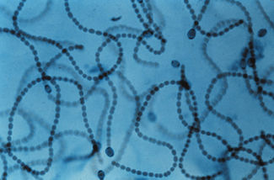
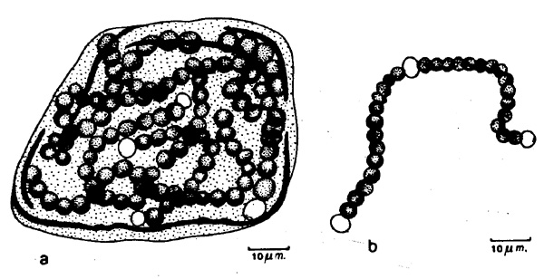
Cyanophyta----Nostoc
Individual Nostoc filaments. Image from Department of Biological Sciences, Michigan Tech.
Nostoc commune Vauch. ex B. & F. Modified from sketch by Zaneveld (1988) from the collection of Manfred Bölter, University of Kiel, DE

Slide 8
Scientific classification
Domain: | Bacteria
Phylum: | Cyanobacteria
Class: | Cyanophyceae
Order: | Nostocales
Family: | Nostocaceae
Genus: | Nostoc Vaucher, 1888, ex Bornet and Flahaul

Slide 9
Cyanophyta
Nostoc
Nostoc is a genus of cyanobacteria found in various environments that forms colonies composed of filaments of moniliform cells in a gelatinous sheath.
The name Nostoc was coined by Paracelsus (Potts, 1997).
Nostoc can be found in soil, on moist rocks, at the bottom of lakes and springs (both fresh- and saltwater), and rarely in marine habitats. It may also grow symbiotically within the tissues of plants, such as the evolutionarily ancient angiosperm Gunnera and the hornworts (a group of bryophytes), providing nitrogen to its host through the action of terminally differentiated cells known as heterocysts. These bacteria contain photosynthetic pigments in their cytoplasm to perform photosynthesis (Guiry et al., 2007).

Slide 10
cells arranged in beadlike chains that are grouped together in a gelatinous mass ranging from microscopic to walnut-sized.
Masses of Nostoc may be found on soil and floating in quiet water.
Reproduction is by fragmentation.
A special thick-walled cell (akinete) has the ability to withstand desiccation for long periods of time. After 70 years of dry storage, the akinete of one species germinates into a filament when moistened.
Like most blue-green algae, Nostoc contains two pigments, blue phycocyanin and red phycoerythrin, as well as chlorophyll, and has the ability to fix nitrogen in specialized cells called heterocysts.
A terrestrial species has been used as a supplementary food source in Asia.
https://www.britannica.com/science/Nostoc
For more info. Please see the video on https://www.youtube.com/watch?v=F2lmdQHGeOc

Slide 11
References
Potts, M. (1997). "Etymology of the Genus Name Nostoc (Cyanobacteria)" (PDF). International Journal of Systematic Bacteriology. 47 (2): 584. doi:10.1099/00207713-47-2-584. Archived (PDF) from the original on 2013-08-11. Retrieved 2011-11-05.
Guiry, M.D., John, D.M., Rindi,F. and McCarthy, T.K.2007. New Survey of Clare Island. Volume 6: The Freshwater and Terrestrial Algae. Royal Irish Academy. p.166

Slide 12
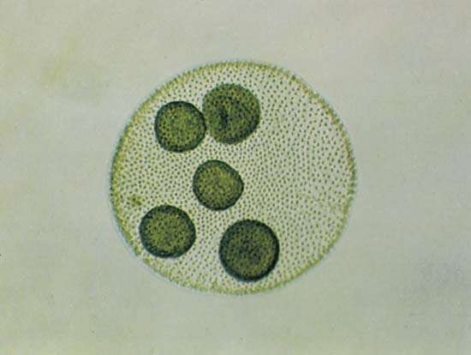
Chlorophyta----Volvox
Volvox
Robert W. Hoshaw/Encyclopædia Britannica, Inc.

Slide 13
Scientific classification
Phylum: | Chlorophyta
Class: | Chlorophyceae
Order: | Chlamydomonadales
Family: | Volvocaceae
Genus: | Volvox L.

Slide 14
Volvox, genus of some 20 species of freshwater green algae (division Chlorophyta) found worldwide. Volvox form spherical or oval hollow colonies that contain some 500 to 60,000 cells em
Volvox colonies were first recorded by Dutch microscopist Antonie van Leeuwenhoek in 1700 and are widely studied as a genetic model of morphogenesis (how organisms develop specialized cells and tissues). Volvox also exhibit differentiation between somatic (non-sex cells) and reproductive cells, a phenomenon considered by some biologists to be significant in tracing the evolution of higher animals from microorganisms. bedded in a gelatinous wall and that are often just visible with the naked eye.
The somatic cells of a Volvox colony each feature two flagella (whiplike appendages), several contractile vacuoles (fluid-regulating organelles), a single chloroplast (the site of photosynthesis), and an eyespot used for light reception. Neighbouring cells are often joined together by strands of cytoplasm, which enable cell-to-cell communication, and the colony moves through water by the coordinated movement of the flagella. The photosynthetic colonies are usually organized so that cells with larger eyespots are grouped at one side to facilitate phototaxis (movement toward light) for photosynthesis, and the reproductive cells are grouped at the opposite side.
Source: https://www.britannica.com/science/Volvox

Slide 15
Most species of Volvox reproduce both asexually and sexually, and some, such as Volvox carteri, switch primary modes of reproduction at least once each year. Asexual colonies have reproductive cells known as gonidia, which produce small daughter colonies that are eventually released from the parent as they mature.
In sexual colonies, developing ova or spermatozoa replace gonidia, and fertilization results in zygotes that form a cyst and are released from the parent colony after its death. Thick-walled zygotes formed late in the summer serve as winter resting stages.
Volvox can be found in ponds, puddles, and bodies of still fresh water throughout the world. As autotrophs, they contribute to the production of oxygen and serve as food for a number of aquatic organisms, especially the microscopic invertebrates called rotifers. One of the most-common species, V. aureus, can form harmful algal blooms in warm waters with a high nitrogen content.
Source: https://www.britannica.com/science/Volvox

Slide 16
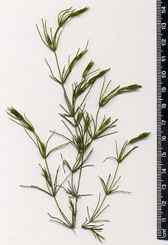
Charophyta-Chara

Slide 17
Scientific classification
Scientific classification
Kingdom: | Plantae
Division: | Charophyta
Class: | Charophyceae
Order: | Charales
Family: | Characeae
Genus: | Chara L., 1753

Slide 18
Chara is a genus of charophyte green algae in the family Characeae. They are multicellular and superficially resemble land plants because of stem-like and leaf-like structures. They are found in fresh water, particularly in limestone areas throughout the northern temperate zone, where they grow submerged, attached to the muddy bottom. They prefer less oxygenated and hard water and are not found in waters where mosquito larvae are present (Barber, 1924). They are covered with calcium carbonate deposits and are commonly known as stoneworts. Cyanobacteria have been found growing as epiphytes on the surfaces of Chara, where they may be involved in fixing nitrogen, which is important to plant nutrition (Sims, G. K.; Dunigan, 1984).
Structure----- The branching system of Chara species is complex with branches derived from apical cells which cut off segments at the base to form nodal and internodal cells alternately (Round, 1965). The main axes bear whorls of branches in a superficial resemblance to Equisetum (a vascular plant) (Bryant, 2007). They are typically anchored to the littoral substrate by means of branching underground rhizoids. Chara plants are rough to the touch because of deposited calcium salts on the cell wall. The metabolic processes associated with this deposition often give Chara plants a distinctive and unpleasant smell of hydrogen sulfide (Round, 1965).

Slide 19
Morphology----The plant body is a gametophyte. It consists of a main axis (differentiated into nodes and internodes), dimorphic branches (long branch of unlimited growth and short branches of limited growth), rhizoids (multicellular with oblique septa) and stipulodes (needle shaped structures at the base of secondary laterals).
Reproduction----Chara reproduces vegetatively and sexually. Vegetative reproduction takes place by tubers, amylum stars and secondary protonemata. The sex organs are a multicellular and jacketed globule or antheridium (male) and nucule or archegonium (female). The antheridia and archegonia may occur on separate plants (dioicy), together on the same plant (conjoined monoicy) or separately on the same plant (sejoined monoicy) (McCracken et al., 1966). After fertilization, the zygote d
Distribition----Chara has a cosmopolitan distribution, from 69 degrees north in northern Norway to about 49 degrees south in Kerguelen Islands (Pal et al., 1962). About 27 species are found in India (Soni, 2015). There are about 40 species of Chara in Europe, where they are commonly found in the specific habitat-type designated as H3140 (hard oligo-mesotrophic waters with benthic vegetation of Chara spp h1) in the Natura 2000 plans of the European Union. Although this habitat is found all across Europe, it is threatened and to be protected and preserved.

Slide 20
References
Barber, M. A. (1924). "The Effect of Chara Robbinsii on Mosquito Larvæ". Public Health Reports. 39 (13): 611–615.
Sims, G. K.; Dunigan, E. P. (1984). "Diurnal and seasonal variations in nitrogenase activity (C2H2 reduction) of rice roots". Soil Biology and Biochemistry. 16: 15–18.
Round, F.E. 1965.The Biology of the algae. Ernest Arnold.
Bryant, J. 2007. The Stoneworts (Chlorophyta. Charales) in Guiry, M.D., John, D.M., Rindi, F. and McCarthy, T.K. 2007. New Survey of Clare Island. Volume 6: The Freshwater and Terrestrial Algae. Royal Irish Academy
McCracken, M.D.; Vernon, W.P.; Arland, T.H. (1966). "Attempted Hybridization between Monoecious and Dioecious Clones of Chara". American Journal of Botany. 53 (9): 937–940.
Soni, N.K. 2015. Fundamentals of Botany Vol. 1, Tata McGraw-Hill Education, p72, ISBN 9780070681767

Slide 21
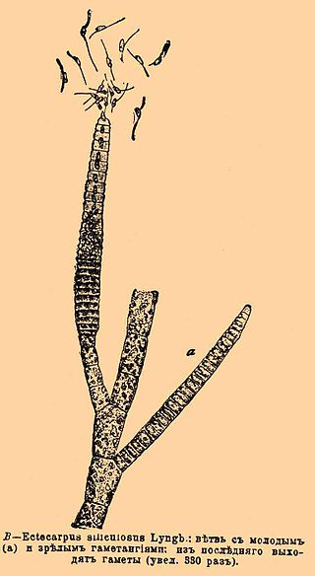
Phaeophyta-Ectocarpus

Slide 22
Scientific classification
Scientific classification
Kingdom: | Chromista
Phylum: | Ochrophyta
Class: | Phaeophyceae
Order: | Ectocarpales
Family: | Ectocarpaceae
Genus: | Ectocarpus Lyngbye 1819

Slide 23
Features of Ectocarpus:
It is a marine brown alga, distributed throughout the temperate and tropical seas of the world.
2. Plant body is filamentous, much branched and heterotrichous, having basal rhizoids and well-developed branched erect system.
3. Both sporophytic and gametophytic plants are alike (isomorphic).
ADVERTISEMENTS:
4. The sporophytic plant bears both plurilo­cular and unilocular sporangia. The plurilo­cular sporangium produces zoospores (2n) through mitosis. They germinate to produce new diploid sporophytic plant. On the other hand, unilocular sporangium produces zoomeiospore through meiosis, followed by several mitotic divisions. Zoomeiospores on germination develop gametophytic plants.
5. The gametophytic plants bear plurilocular gametangia (look similar to plurilocular spo­rangia) produce gametes.
6. Sexual reproduction may be isogamous, anisogamous or oogamous type. Physio­logical anisogamy is very common.
7. Direct germination of zygote results in the formation of a diploid sporophytic plant.
Source: http://www.biologydiscussion.com/algae/ectocarpus-occurrence-features-and-reproduction/46968

Slide 24
Occurrence of Ectocarpus
Different species of the genus Ectocarpus (Cr. ekos — external and kapos — fruit) is found throughout the world, out of which 16 species are found in India. They grow in marine habitat, either free-floating, epiphytes (on other sea plants) or lithophytes (on rocks). They are commonly available in both tropical and temperate seas. In India they are commonly found in the western coast.
Species like E. spongiosus and E. conigerare are free-floating, E. breviarticulatus and E. coniferus grow on larger algae like Laminaria and Fucus as epiphytes. E. dermonematis is endophytic and E. fasciculatus is an epizoic species, grows on the fins of fishes.
Reproduction in Ectocarpus
Sexual Reproduction:
The sexual reproduction is both isogamous and anisogamous type. Oogamy is absent. Anisogamy is very common. Anisogamy may be of two types : morphological anisogamy (E. secundus) and physiological anisogamy (E. siliculosus). The gametes are produced inside the plurilocular gametangia, developed on haploid plants.
Sourse: http://www.biologydiscussion.com/algae/ectocarpus-occurrence-features-and-reproduction/46968

Slide 26
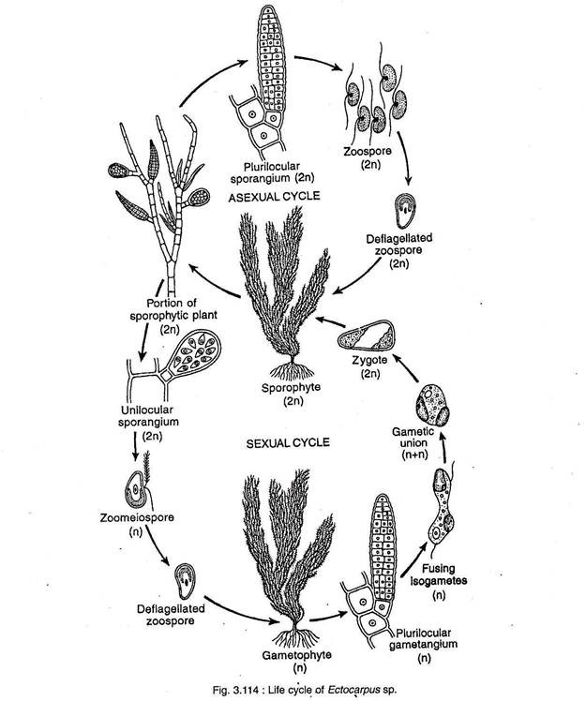
Detail of this figure can be viewed from http://www.biologydiscussion.com/algae/ectocarpus-occurrence-features-and-reproduction/46968

Slide 27
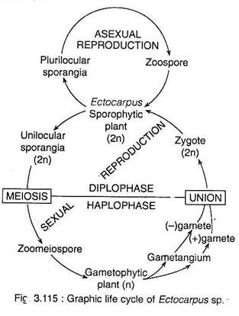
Detail of this figure can be viewed from http://www.biologydiscussion.com/algae/ectocarpus-occurrence-features-and-reproduction/46968

Slide 28
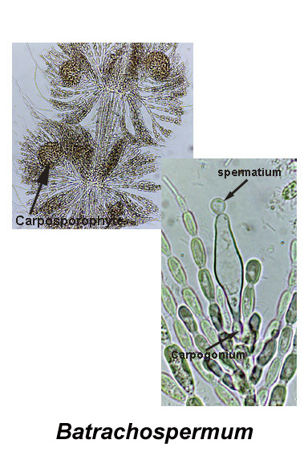
Rhodophyta - Batrachospermum

Slide 29
Scientific classification
(unranked): Archaeplastida
Division: Rhodophyta
Class: Florideophyceae
Order: Batrachospermales
Family: Batrachospermaceae
Genus: Batrachospermum Roth, 1797

Slide 30
General characteristics
Red algae, or Rhodophyta are one of the oldest groups of eukaryotic algae (Lee, 2008).
The Rhodophyta also comprises one of the largest phyla of algae, containing over 7,000 currently recognized species with taxonomic revisions ongoing(Guiry, M.D.; Guiry, 2016).
The majority of species (6,793) are found in the Florideophyceae (class), and mostly consist of multicellular, marine algae, including many notable seaweeds (Thomas, 2002).
Approximately 5% of the red algae occur in freshwater environments with greater concentrations found in warmer areas (Sheath, 1984).
Except for two coastal cave dwelling species in the asexual class Cyanidiophyceae, there are no terrestrial species, which may be due to an evolutionary bottleneck where the last common ancestor lost about 25% of its core genes and much of its evolutionary plasticity (Azua-Bustos et al., 2012).

Slide 31
The red algae form a distinct group characterized by having eukaryotic cells without flagella and centrioles, chloroplasts that lack external endoplasmic reticulum and contain unstacked (stroma) thylakoids, and use phycobiliproteins as accessory pigments, which give them their red color (Woelkerling, 1990).
starch, which is a type of starch that consists of highly branched amylopectin without amylose (Viola et al., 2001), as food reserves outside their plastids.
Most red algae are also multicellular, macroscopic, marine, and reproduce sexually. The red algal life history is typically an alternation of generations that may have three generations rather than two (autocww.colorado.edu).
The coralline algae, which secrete calcium carbonate and play a major role in building coral reefs, belong here. Red algae such as dulse (Palmaria palmata) and laver (nori/gim) are a traditional part of European and Asian cuisines and are used to make other products such as agar, carrageenans and other food additives (Guiry, 2007).

Slide 32
Batrachospermum, genus of freshwater red algae (family Batrachospermaceae) ranging in colour from violet to blue-green.
The long, branched, threadlike filaments bear dense whorls of branchlets, resembling beads on a string.
Spores are formed in clusters around the base of the carpogonium (female sex organ) after fertilization.
The genus is widely distributed and can be found in cool streams and in pools in sphagnum bogs.
Source: https://www.britannica.com/science/algae

Slide 33
References:
Lee, R.E. (2008). Phycology (4th ed.). Cambridge University Press. ISBN 978-0-521-63883-8.
Guiry, M.D.; Guiry, G.M. (2016). "Algaebase". www.algaebase.org. Retrieved November 20, 2016.
D. Thomas (2002). Seaweeds. Life Series. Natural History Museum, London. ISBN 978-0-565-09175-0.
Sheath, Robert G. (1984). "The biology of freshwater red algae". Progress Phycological Research. 3: 89–157.
Azua-Bustos, A; González-Silva, C; Arenas-Fajardo, C; Vicuña, R (2012). "Extreme environments as potential drivers of convergent evolution by exaptation: the Atacama Desert Coastal Range case". Front Microbiol. 3: 426. doi:10.3389/fmicb.2012.00426. PMC 3526103. PMID 23267354.
W. J. Woelkerling (1990). "An introduction". In K. M. Cole; R. G. Sheath (eds.). Biology of the Red Algae. Cambridge University Press, Cambridge. pp. 1–6. ISBN 978-0-521-34301-5.
Viola, R.; Nyvall, P.; Pedersén, M. (2001). "The unique features of starch metabolism in red algae". Proceedings of the Royal Society of London B. 268 (1474): 1417–1422. doi:10.1098/rspb.2001.1644. PMC 1088757. PMID 11429143.
"Algae". autocww.colorado.edu.
M. D. Guiry. "Rhodophyta: red algae". National University of Ireland, Galway. Archived from the original on 2007-05-04. Retrieved 2007-06-28.

